Slide 1
Spell checking using
Deep Learning Approach
Project update 19th November 2020
0856706 Susan Ku
0856156 Huong Vu

Slide 2
What we have completed?
Data re-processing : successfully processed for small set of data
Pseudo code:
finalize the model architecture and complete the pseudo code
analyze one sample code

Slide 3
Data re-processing
Assign a number (indices) to all characters in the alphabet
Each character in a word can be regarded as a vector.
Special tokens used in seq2seq
<start of string> & <end of string>
<unknown>
<pad>
Convert words into tensor
Ref: PyTorch Tutorials > NLP From Scratch: Translation with a Sequence to Sequence Network and Attention

Slide 4
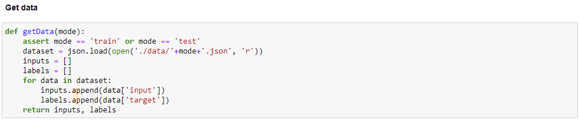
Data re-processing

Slide 5
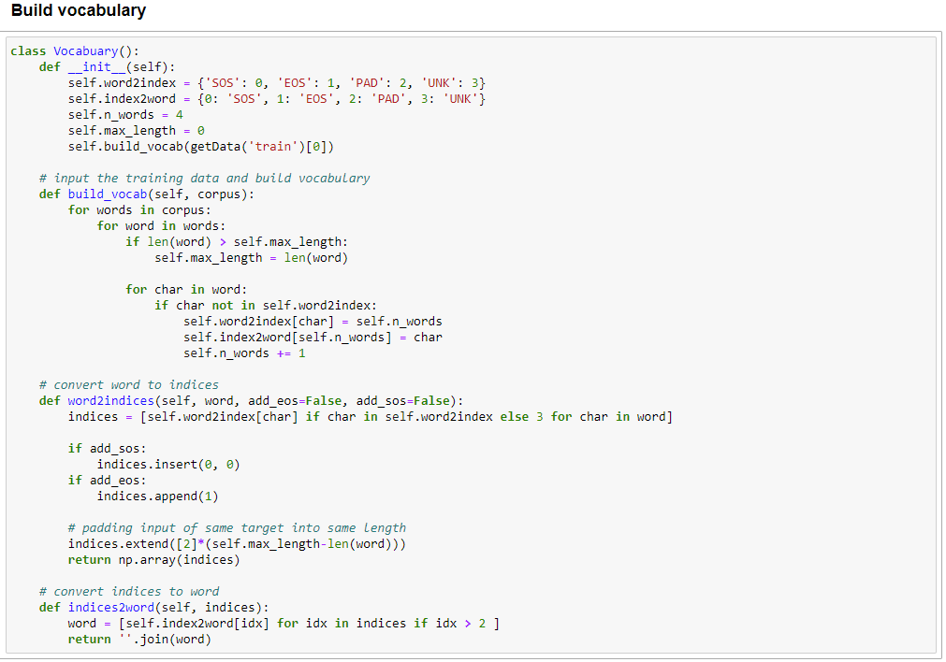
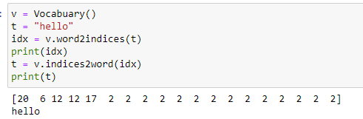
Data re-processing

Slide 6
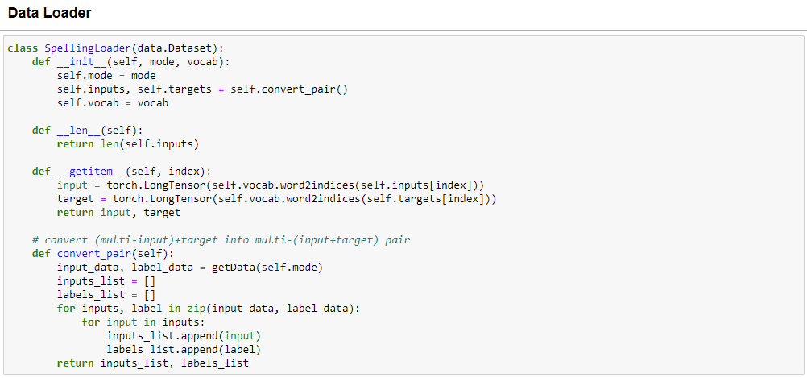
Data re-processing

Slide 7
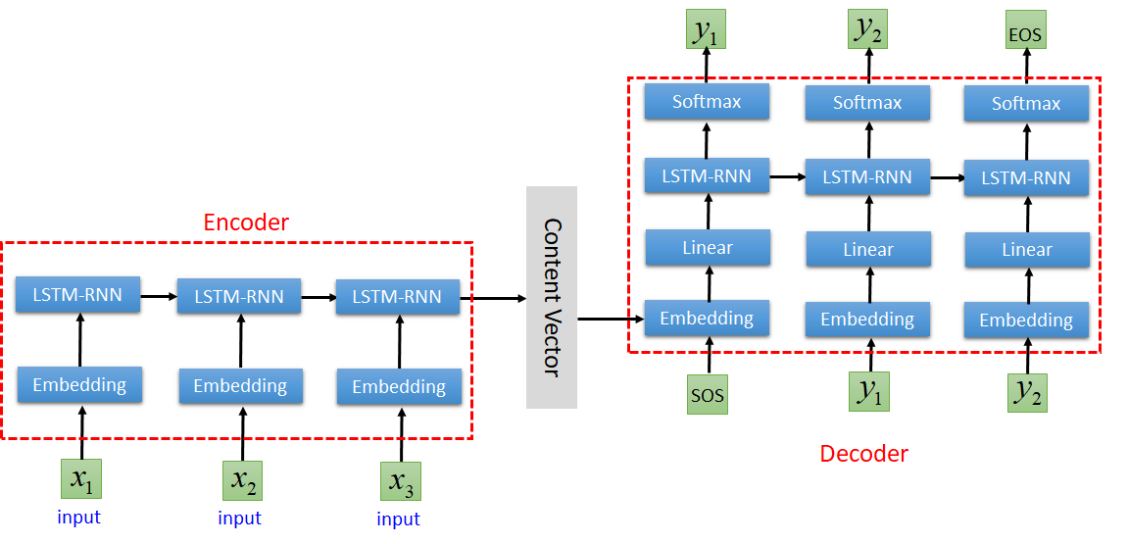
Architecture

Slide 8
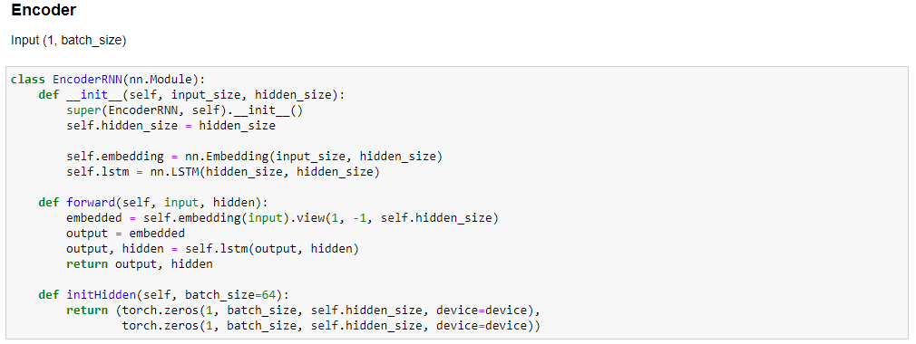
Encoder

Slide 9
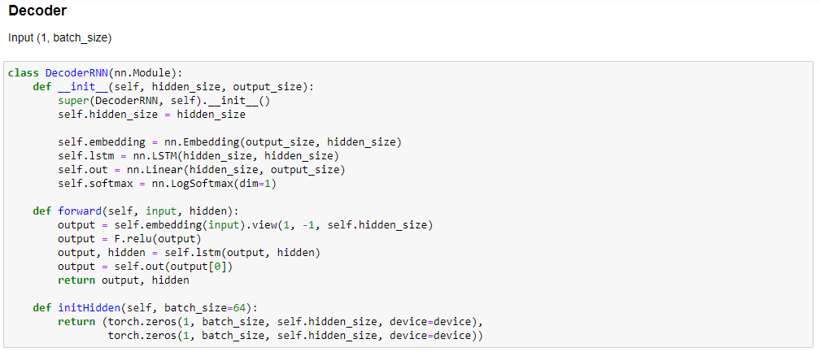
Decoder

